Slide 1
Gene set enrichment (GSEA) and overrepresentation analysis (ORA)
Friederike Ehrhart

Slide 2
RNAseq data analysis workflow
Data pre-processing
Statistical analysis
Further analysis
Genome mapping
Stat result
Norm data
(Raw)
counts
Reads
Genome sequence
Genome annotation
Filtering
Scans
Quality control
Quality control
Quality control
Dependency on biological
question
Dependency on technology

Slide 3
What’s next?: Further analyses
Once we have found a list of genes which are significantly changed between two groups, we often still have 1,000’s of genes to consider.
We may use only the most changed genes only to further study the differences between the groups
Or search the literature
Or…apply:
Clustering methods
Correlation methods
Classification methods
Pathway analysis
Gene Set Enrichment Analysis
Gene Ontology analysis
Network analysis
…
Eventually, get back to the lab or study subjects to biologically verify findings

Slide 4
Biological interpretation
Lists of differentially expressed genes (or other biological entities)
Clustering
Correlation (-> WGCNA on Wednesday)
Classification
Gene Set Enrichtment Analysis (GSEA) or Overrepresentation analysis (ORA) (including pathway and Gene Ontology analysis)
Network analysis (Friday)
Biological interpretation
Items in bold to be discussed further in this course

Slide 5
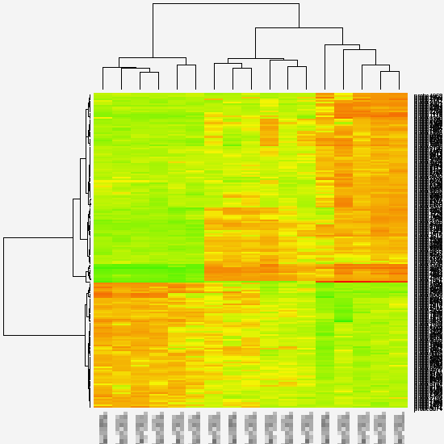
Clustering
To find groups of similar profiles
Unsupervised (as in QC) or supervised (e.g. preselected genes)
Hierarchical clustering of both samples and genes
Other methods available (e.g. K-means)
Image: Dr. J. Pennings, RIVM, NL

Slide 6
Correlation
Correlation expression profiles to
another feature of interest (e.g., a phenotype)
following a certain pattern (e.g.,increasing over time)
expression profiles of other genes
Which gene is more similar to Gene1?
Gene 3
Gene 1
expression
Gene 2
time

Slide 7
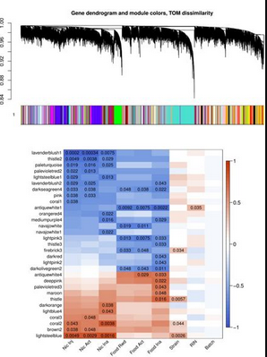
Weighted gene co-expression network analysis (WGCNA)
Extracts gene co-expression similarity – genes, that are together up or down regulated
Checks pairwise correlation between co-expression clusters and clinical phenotype
Weights this correlation based on prior knowledge
More tomorrow!

Slide 8
Gene set enrichment vs. overrepresentation analysis
Overrepresentation asks, "Which pathways have more genes in this list than what you would expect from random chance?" It essentially analyzes the pathway composition of a gene list compared to the pathway composition of the entire annotated gene set.
Gene Set Enrichment asks, "Which pathways in this data set are most prevalent?" The analysis is focused on the input dataset in this case
https://www.reddit.com/r/bioinformatics
u/Stewthulhu

Slide 9
Overrepresentation analysis (ORA)
Unchanged gene
Changed gene
Question:
Does the small circle have a higher percentage of changed genes than the large circle?
Is this difference significant?
→ Fisher test: Z-score

Slide 10

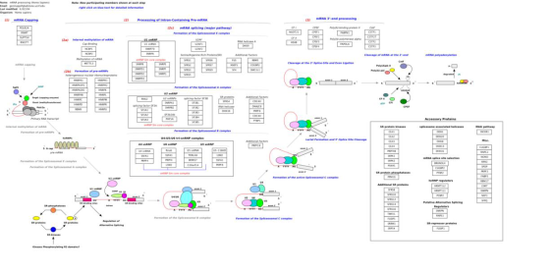
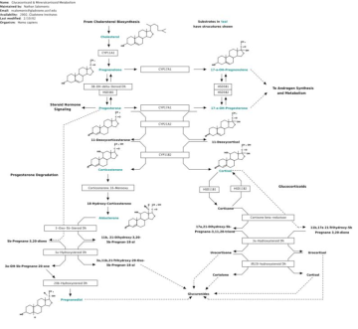
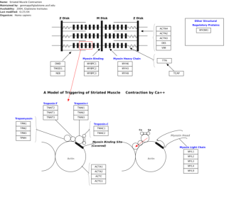
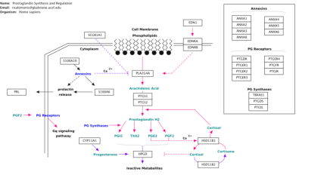
Biological pathways (from WikiPathways)

Slide 11
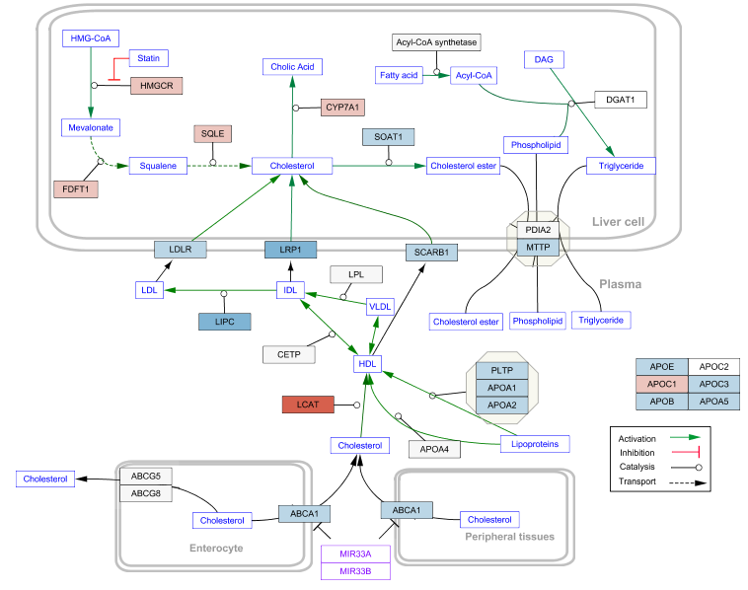


PathVisio
Example:
map ²logFC data from RNA-seq
(you can also add
p-values)
More Thursday!
Image: www.wikipathways.org

Slide 12
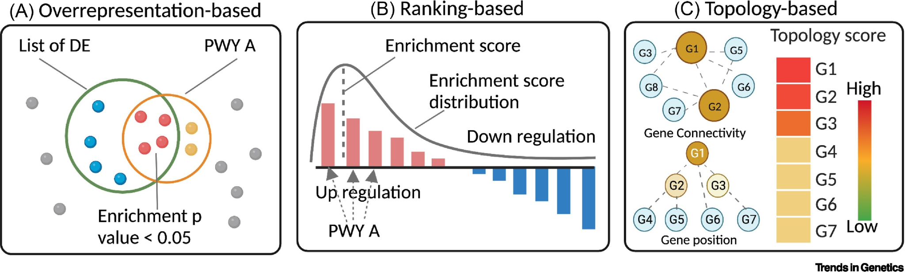
Pathway analysis
Molecular pathways can be treated as gene sets = disregarding interaction information (ORA/GSEA)
Or taking this information into account (Topology based)
https://doi.org10.1016/j.tig.2023.01.003

Slide 13
Gene Set Enrichment Analysis
Rank all genes based on their expression changes and/or significances
Check whether the genes in a certain gene set (which could represent a pathway) are more in the top of this list than expected by chance
By tracking an enrichment score
Perform permutation tests to estimate significance

Slide 14

Gene Ontology (GO) analysis
Similar to pathway overrepresentation analysis, but testing genes in GO terms
These are terms that indicate biological processes, molecular functions, and cellular localisations that proteins are involved in
These terms are in a tree-structure (nested, dependent!)
To avoid multiple related terms in the results, select the best node from each branch in the tree

Slide 15

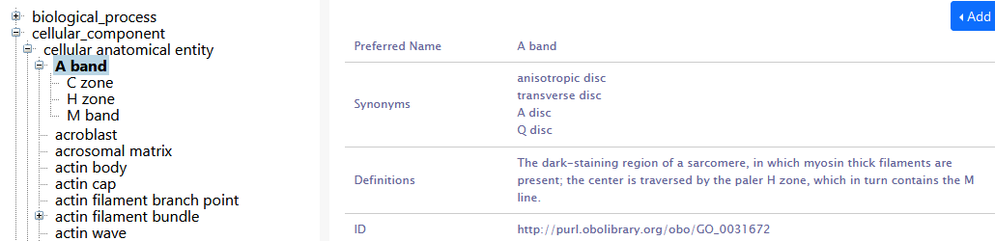
Gene Ontology
Ontology:
Hierarchical, classified language models –> parent class – child class
Machine readable unique persistent identifiers
Gene ontology (GO): genes are annotated with GO terms
https://bioportal.bioontology.org/ontologies/GO

Slide 16
But wait, there is more…
Gene sets annotated with additional information on
Disease-gene relationships (DisGeNET)
Phenotype – gene relationship (HPO - human phenotype ontology)
Gene – transcription factor interactions (ENCODE)
Gene expression in different tissues (ProteinAtlas)

Slide 17

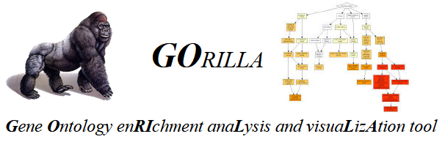



Tools for GSEA/ORA
Webtools
EnrichR
g:Profiler (g:GOSt)
R packages
ggprofiler2
QIAGEN Ingenuity Pathway Analysis (IPA)

Slide 18
Hands-on
Tutorial can be found in “Hands-on EnrichR and gProfiler.doc“
Webtools for both, EnrichR and g:Gost
R script how to use the R package ggprofiler2 “gProfiler.R”

